Slide 1
Acquisition and onboarding customer journey

Slide 2
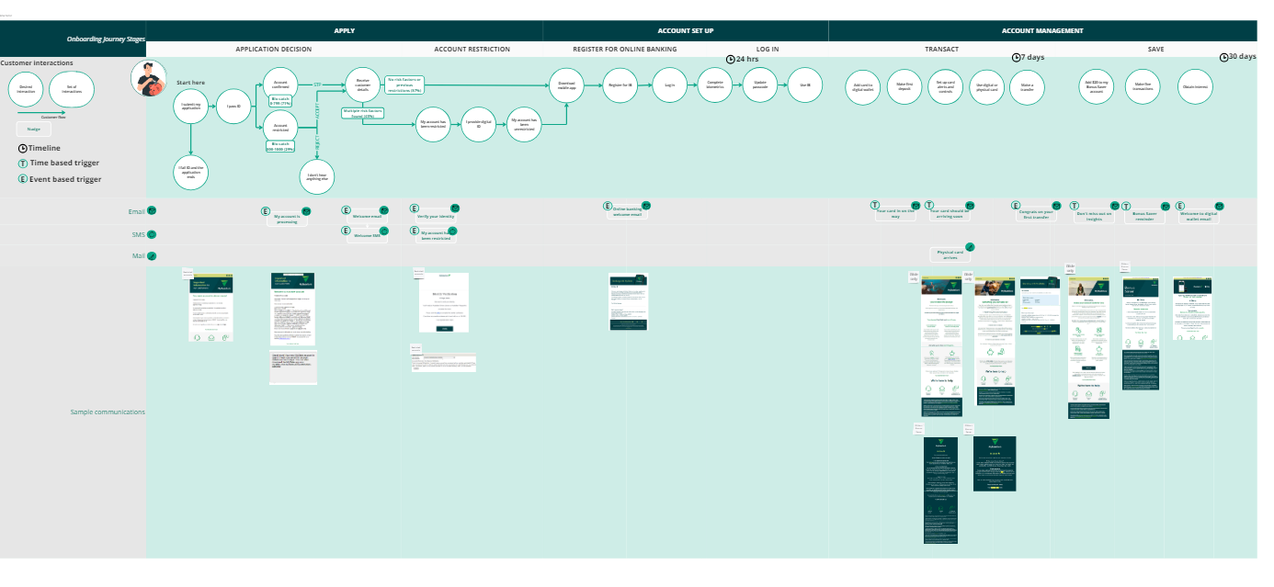
ACQUISITION & ONBOARDING CUSTOMER JOURNEY
OVERVIEW
This document breaks down the different communications touch points delivered to customers during the onboarding journey across successful and unsuccessful applicant scenarios.
It is split by journey phases, apply, set up and manage.
It is a customer-first map, designed to convey the experience of the customer. It does not include a deep dive into the back end process.

Slide 3
Current state customer flow

Slide 4

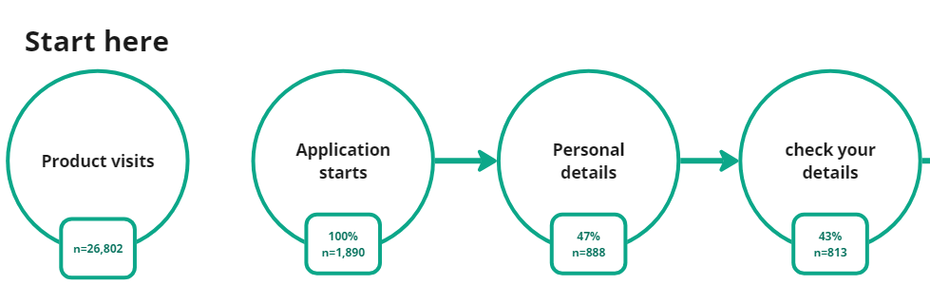
ACQUISITION & ONBOARDING CUSTOMER JOURNEY
0-24 HOURS
APPLY
APPLICATION
Through to submit application
E=event trigger
T= time trigger
COMMS
TOUCH POITNS

Slide 5
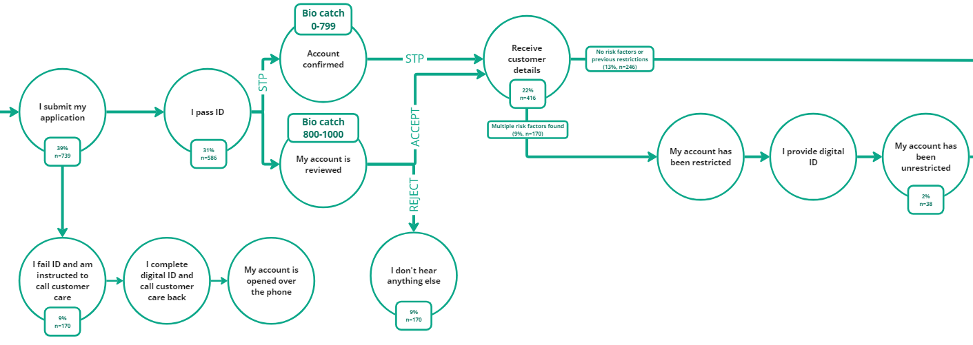
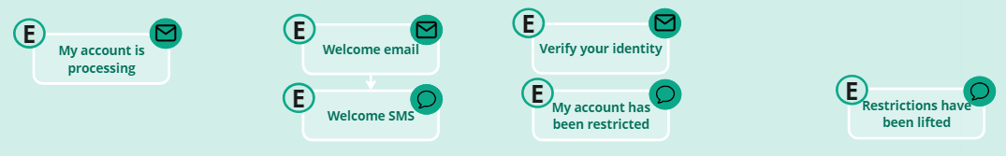
ACQUISITION & ONBOARDING CUSTOMER JOURNEY
0-24 HOURS
APPLY
SUBMISSION
ACCOUNT OUTCOME
Back to submit your details
Through to download app
No hold on time based on boarding communications for restricted customers – see page 7/8
E=event trigger
T= time trigger
COMMS
TOUCH POITNS

Slide 6
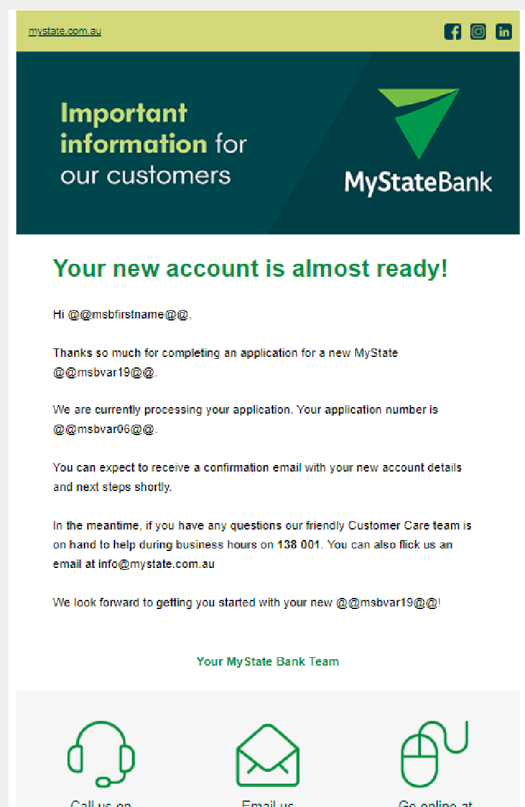
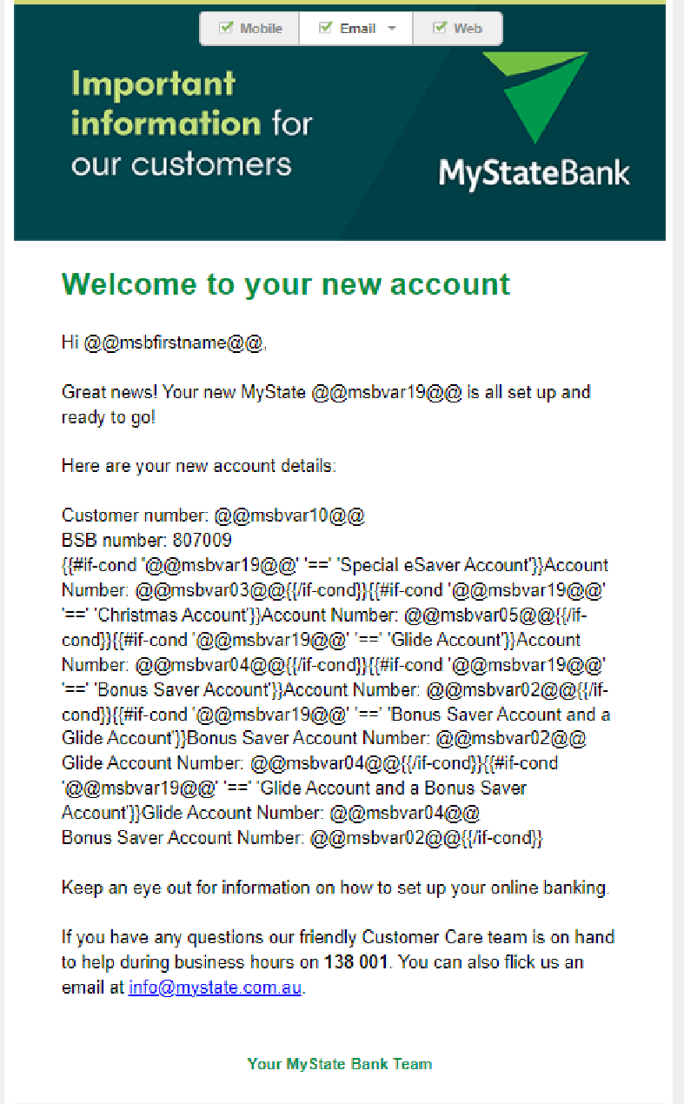
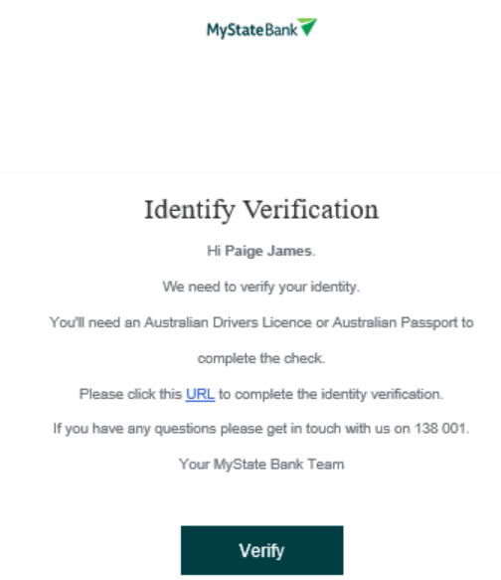
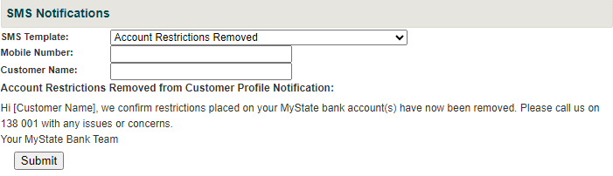
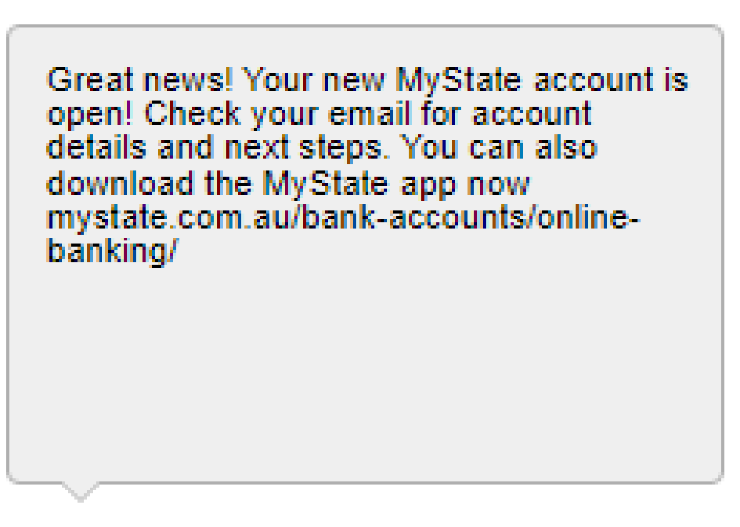
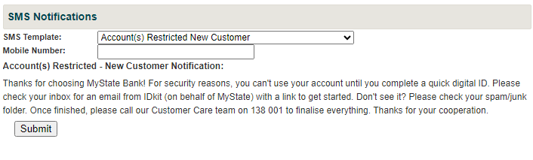
ACQUISITION & ONBOARDING CUSTOMER JOURNEY
0-24 HOURS
APPLY
E=event trigger
T= time trigger
COMMS
TOUCH POITNS
SAMPLE MATERIALS

Slide 7
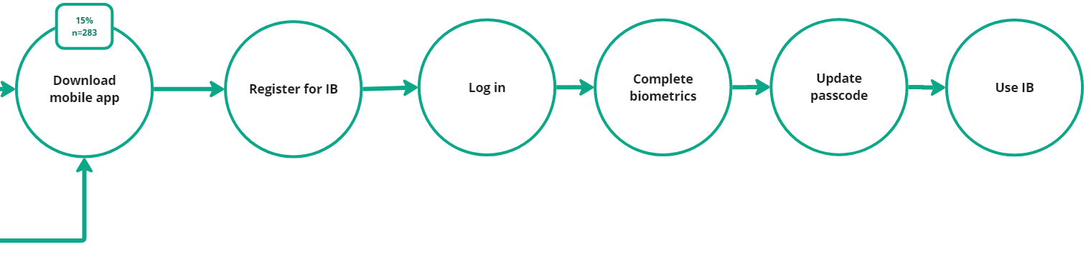
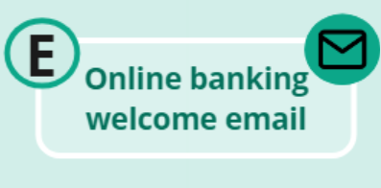
ACQUISITION & ONBOARDING CUSTOMER JOURNEY
0-24 HOURS
SET UP
REGISTER FOR ONLINE BANKING
LOG IN
Back to account outcome
Back to account outcome
E=event trigger
T= time trigger
COMMS
TOUCH POITNS

Slide 8
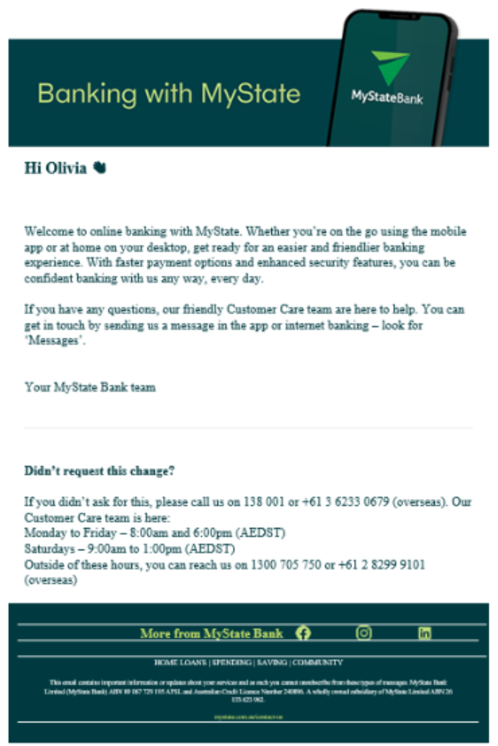
ACQUISITION & ONBOARDING CUSTOMER JOURNEY
0-24 HOURS
SET UP
E=event trigger
T= time trigger
COMMS
TOUCH POITNS
SAMPLE MATERIALS

Slide 9
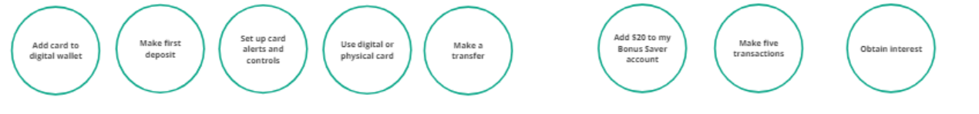
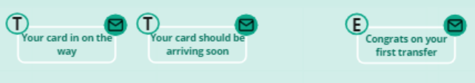
ACQUISITION & ONBOARDING CUSTOMER JOURNEY
1- 30 DAYS
MANAGE
TRANSACT
SAVE
CUSTOMER
INTERACTIONS
Please note: Customer interactions may occur in any order
E=event trigger
T= time trigger
COMMS
TOUCH POITNS
Delivered for
restricted accounts
Delivered for
restricted accounts
Delivered for
restricted accounts
Delivered for
restricted accounts

Slide 10
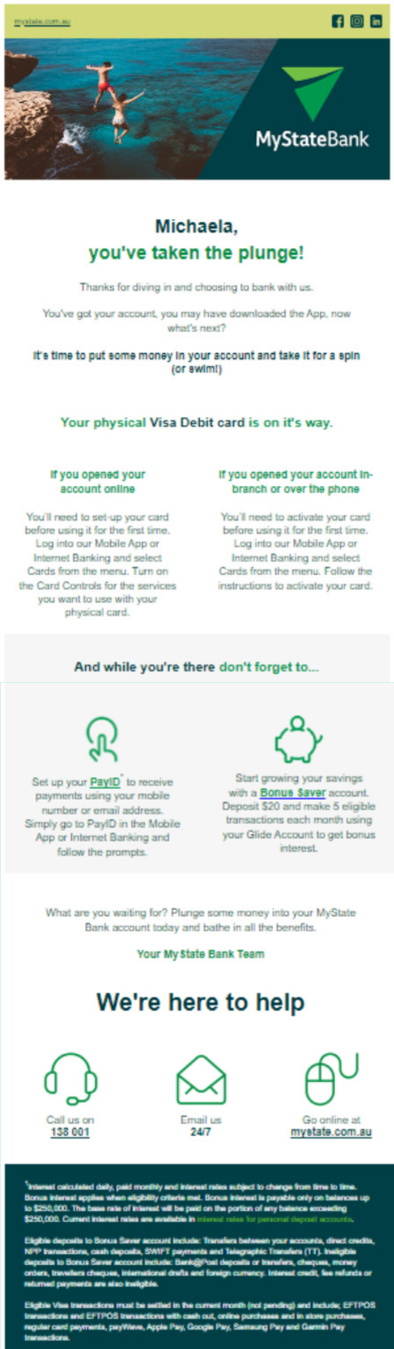
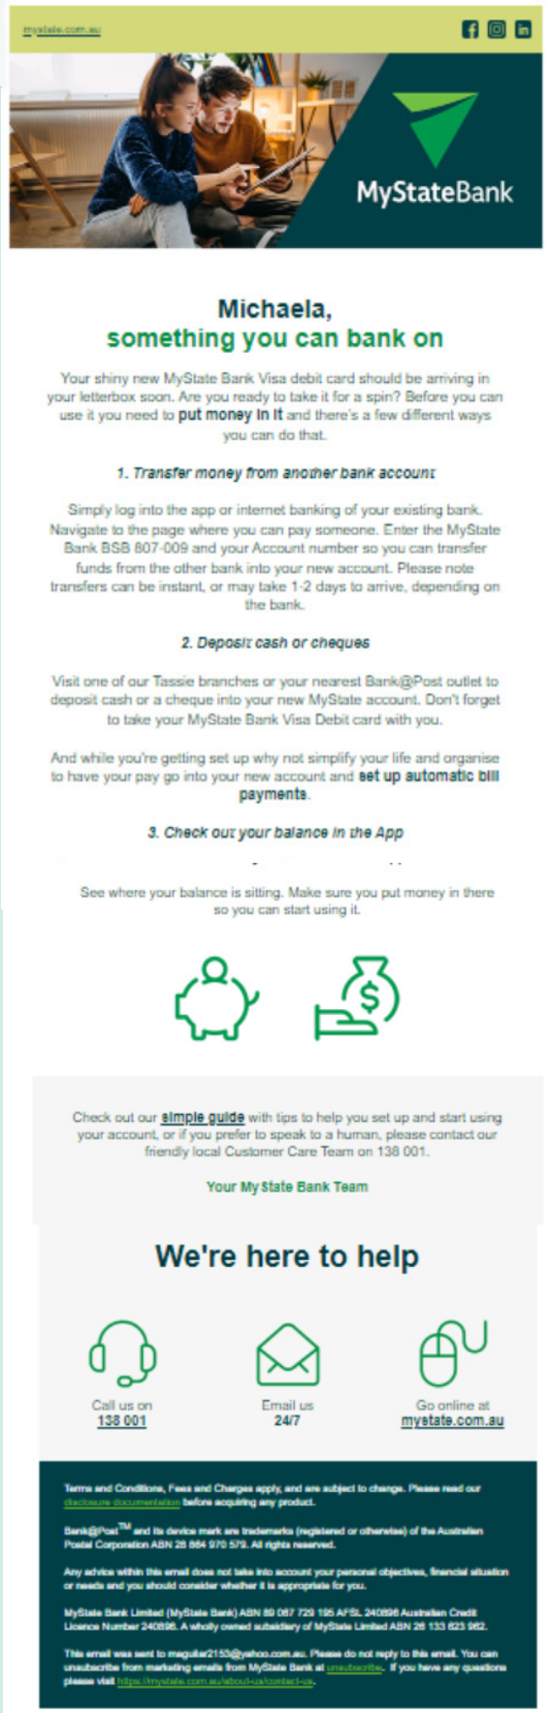
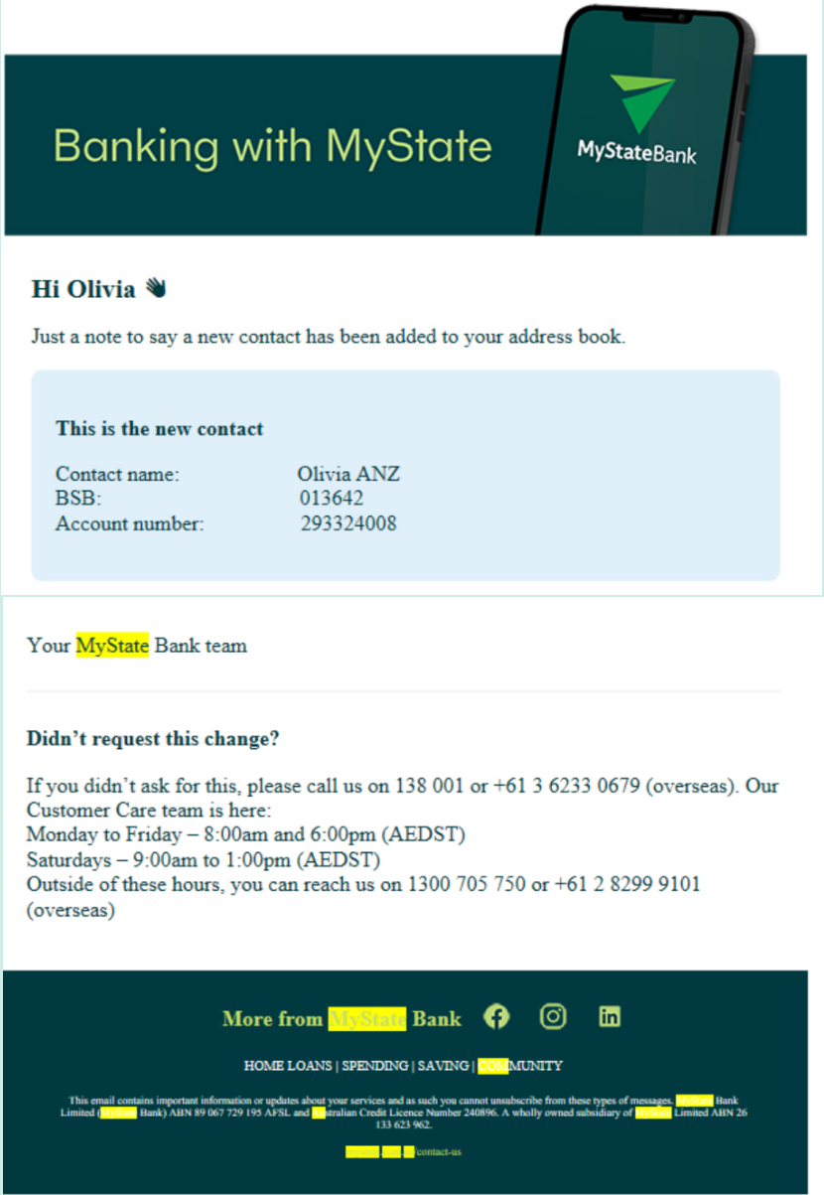
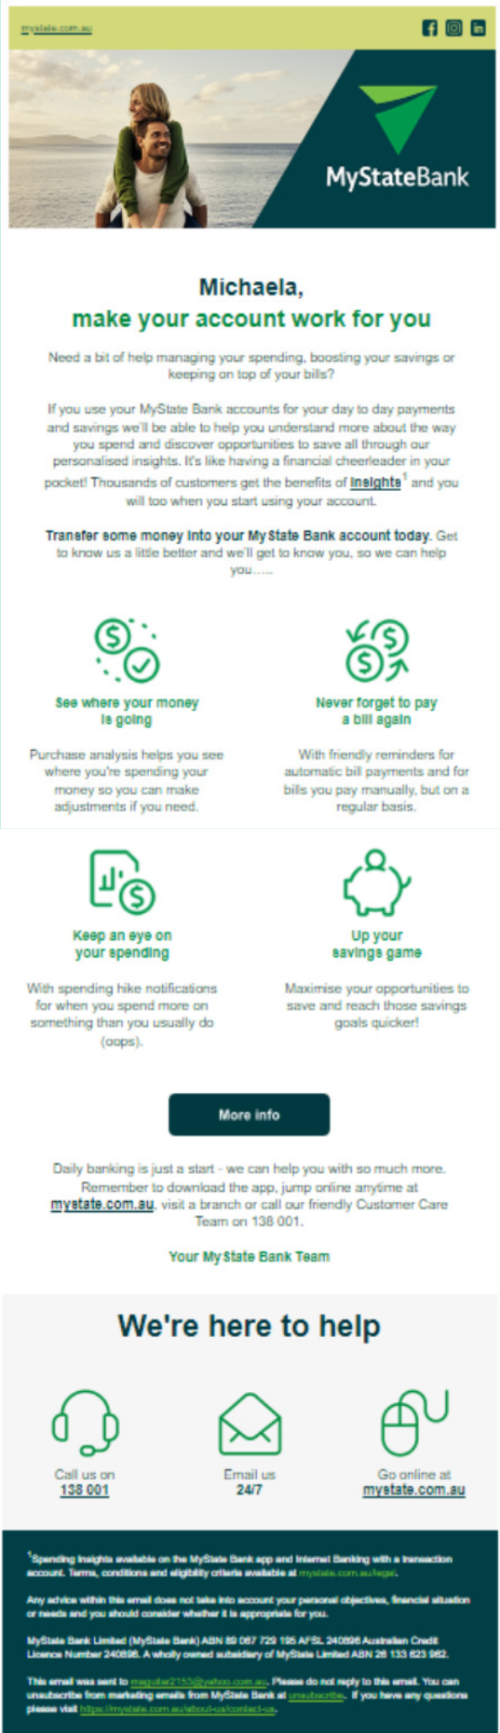
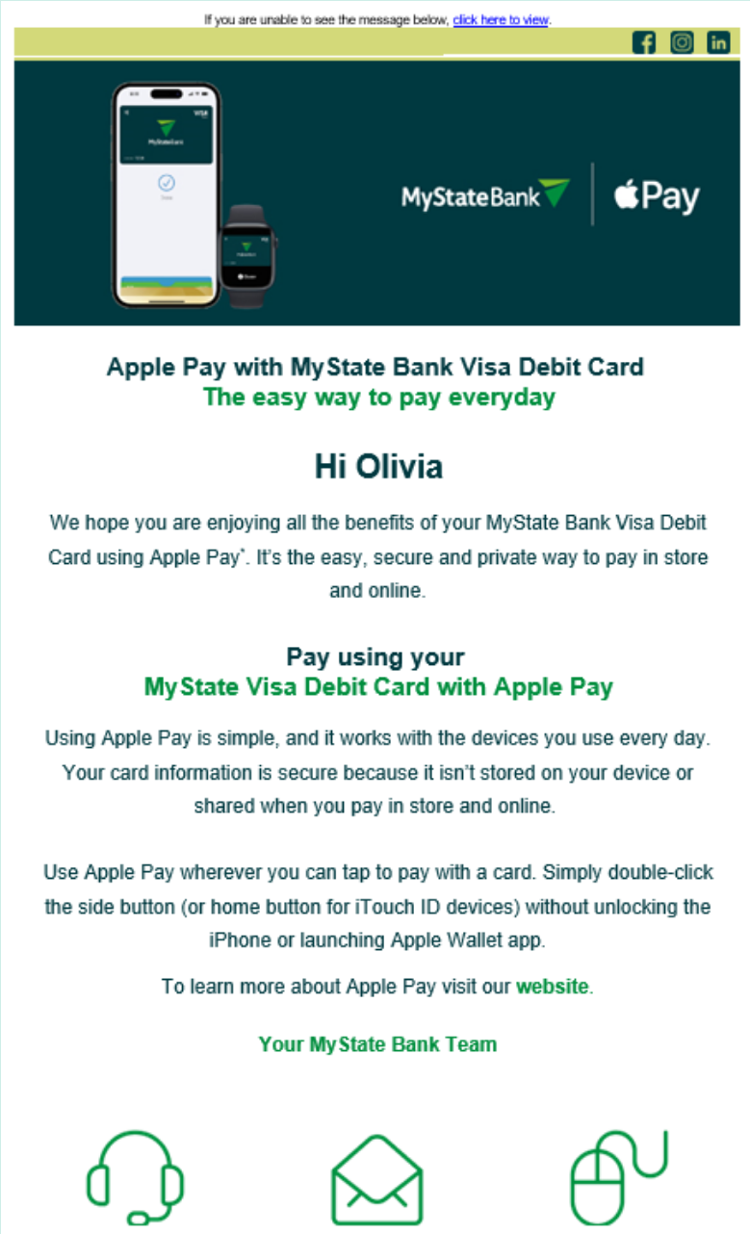
ACQUISITION & ONBOARDING CUSTOMER JOURNEY
1- 30 DAYS
MANAGE – GLIDE ONLY
E=event trigger
T= time trigger
COMMS
TOUCH POITNS
Delivered for
restricted accounts
Delivered for
restricted accounts
Delivered for
restricted accounts
SAMPLE MATERIALS

Slide 11
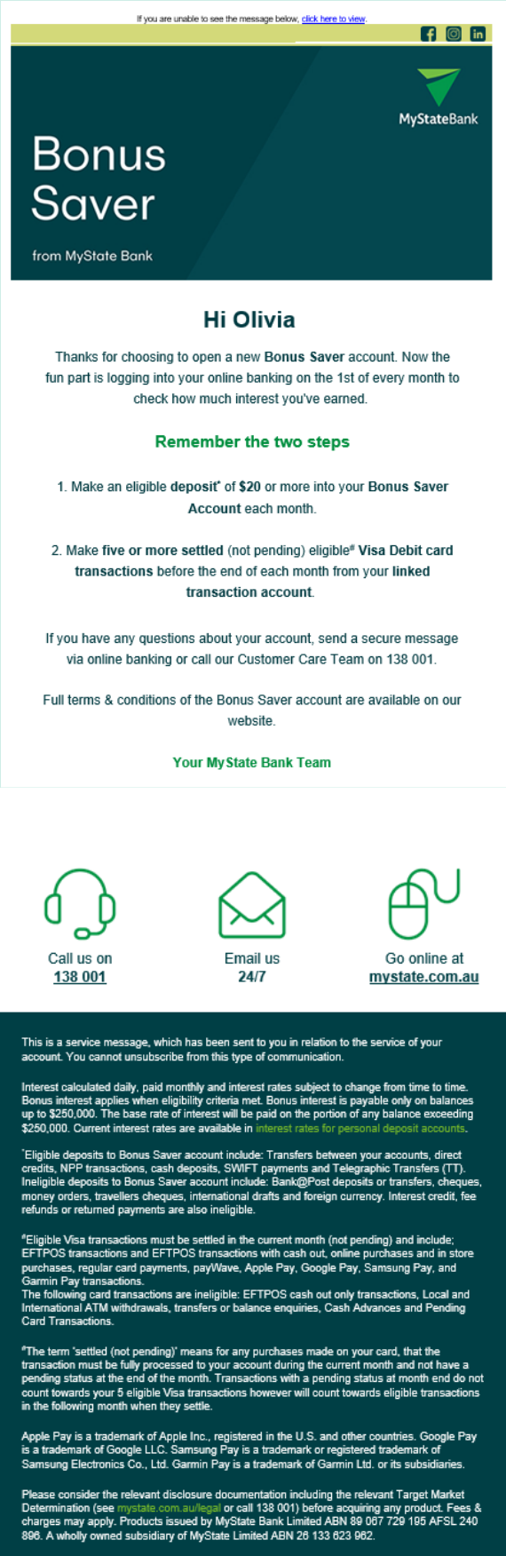
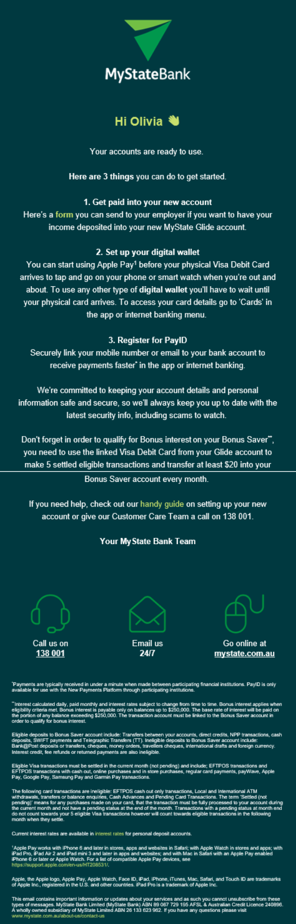
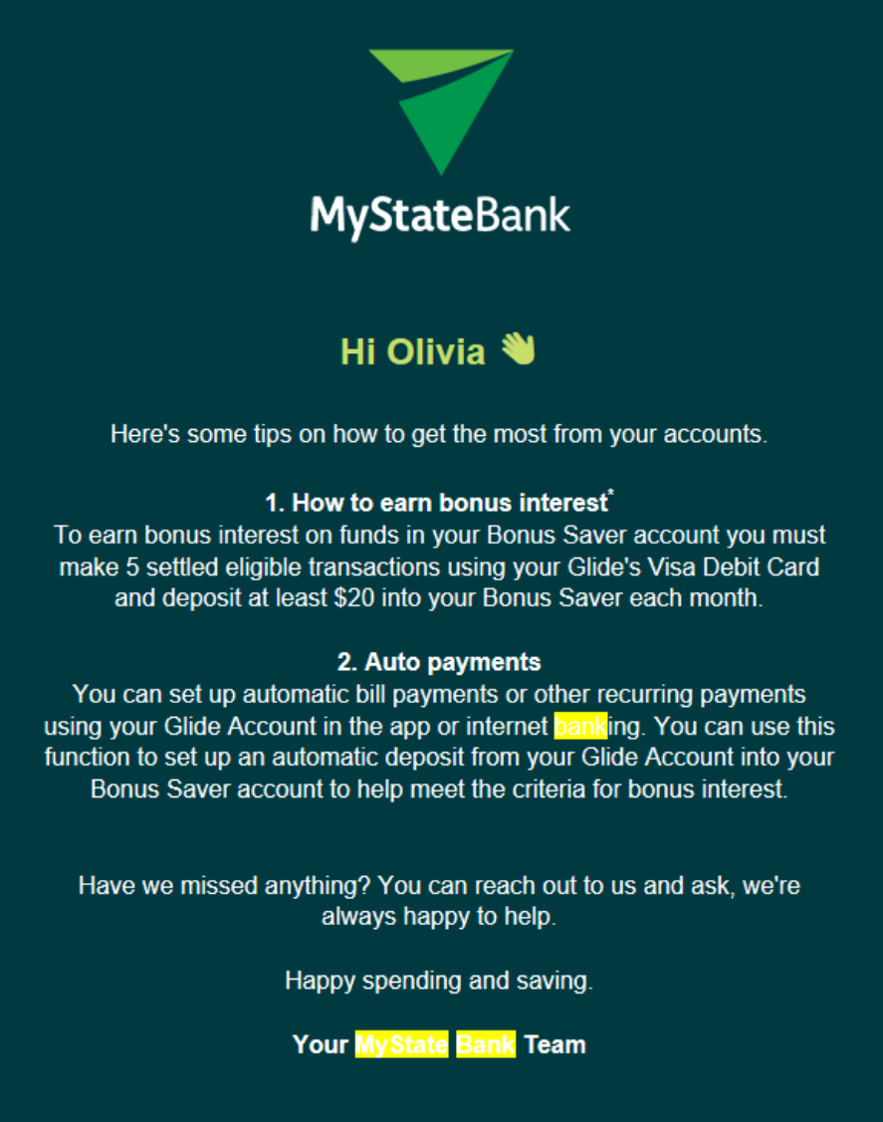
ACQUISITION & ONBOARDING CUSTOMER JOURNEY
1- 30 DAYS
MANAGE – GLIDE AND BONUS SAVER
E=event trigger
T= time trigger
COMMS
TOUCH POITNS
Delivered for
restricted accounts
Delivered for
restricted accounts
Delivered for
restricted accounts
SAMPLE MATERIALS

Slide 12
Target state journey

Slide 13
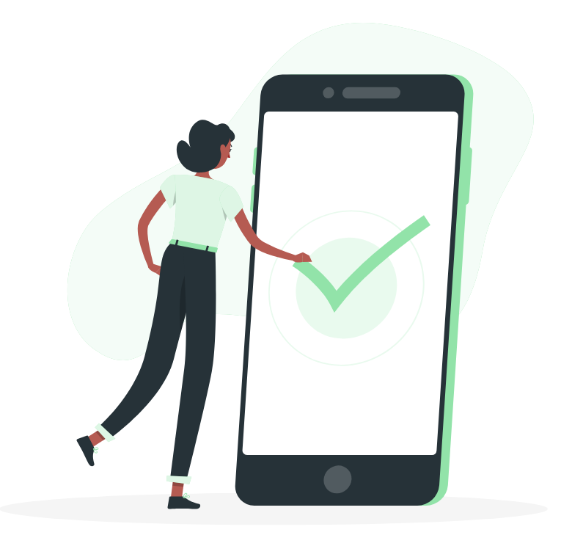

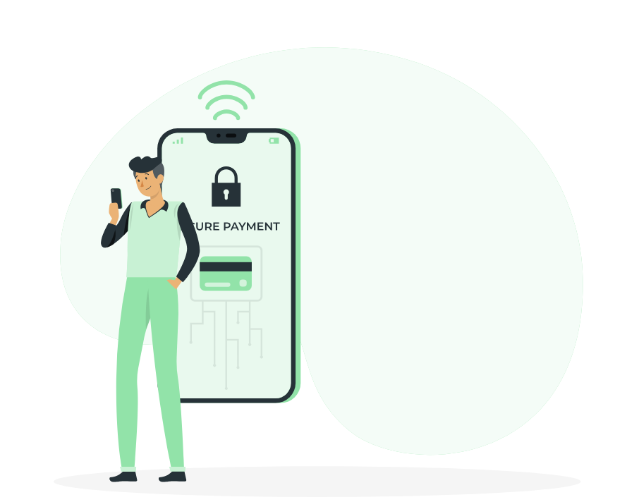
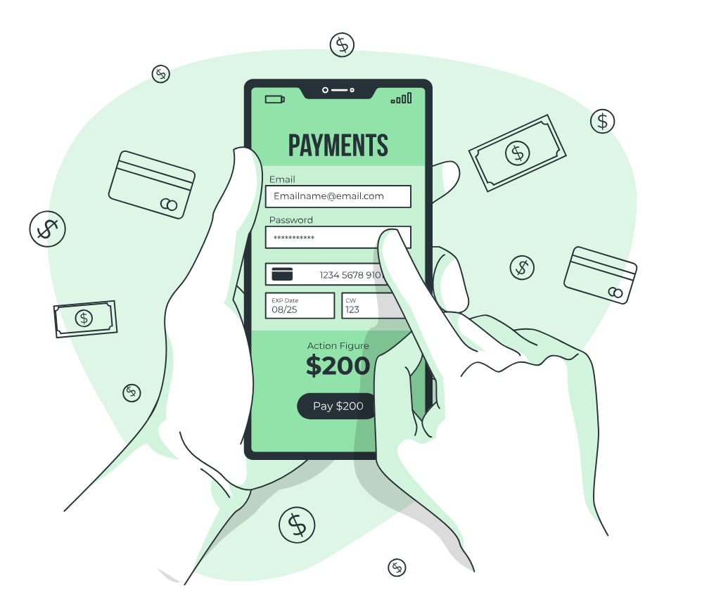

Target state acquisition and onboarding customer experience
Account confirmed Customer details obtained | Mobile app downloaded Password created | Successful log in Digital tool overview Personalise e.g., savings goals Digital wallet set up Biometrics set up Set up PayID | Make first deposit Add salary Update recurring payments Set up card alerts and controls Grow balance | Set up recurring payments Make criteria Obtain interest Grow balance
I feel confident my information is secure, and my privacy is protected. The confirmation process was simple and felt easy. I received a welcome kit filled with information about my account features, making me feel informed and excited about my new bank. I trust my new bank and feel like they know me, and I know them. I know where to get help if I need it, including being able to chat to someone in real life. | The online banking set up was straightforward, with clear instructions that helped me get started quickly including when I can use my account. I feel reassured my information is safe. I appreciate the clear explanation of fees and benefits, it made my fee secure knowing what to expect. | I want to know what communications I should be expecting. The tools provided to help me set and track my savings goals made me feel supported in my financial journey. I have the ability to personalise my account if I want to. Give me immediate access to my money, so I can start meeting the criteria for my interest. Ensure the digital wallet is as safe and secure as other payment methods, in real time. | I want to be reassured everything is working smoothly, and I trust MyState before I consider sending more money. I want the option to provide feedback and feel have the sense that someone genuinely cares about me and my experience. I have immediate access to my money, or clear information about when I will be able to access it. I feel supported | I want to easily make my interest every month, without too much stress or worry. The time and mental capacity to set up automated debits and credits into my new account.
APPLY
SET UP
MANAGE
STAGES
ACCOUNT CONFIRMED
ONLINE BANKING REGISTRATION
INITIAL LOGIN
DEPOSIT AND TRANSACT
SAVE
Wow that was so easy, I know exactly what I need to do to
get started
I feel like I know and can trust MyState
Logging into online banking is super easy
I am excited to start using my new account, and appreciate being able to add savings goals
I love the way I could start spending straight away, helping me earn my interest
Everything has been working as it should!
It is easy to make my interest every month
CUSTOMER EXPERIENCE
My data and information feels safe
I feel invested in my new account
My data and information feels safe
DESIRED
BEHAVIOURS
MOMENTS THAT
MATTER
IMPROVE COMPREHENSION
OPPORTUNITIES
BUILD MOTIVATION
INCREASE TRUST
IMPROVE USERBILITY
IN TRAIN
INITIATIVES
CVP & SEGMENTATION
GINAN UPDATES (including release four)
SCAMS TACTICAL INITIATIVES
APP STORE RESEARCH
BONUS SAVER COMMS REVIEW
TECHNOLOGY AND DATA
ENABLERS
PEOPLE AND TRAINING
PRODUCTS AND SERVICES

